Slide 1
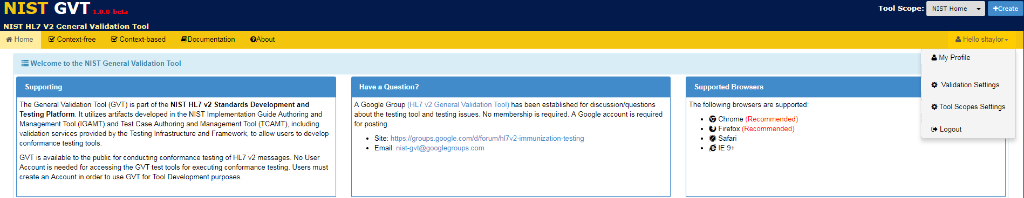
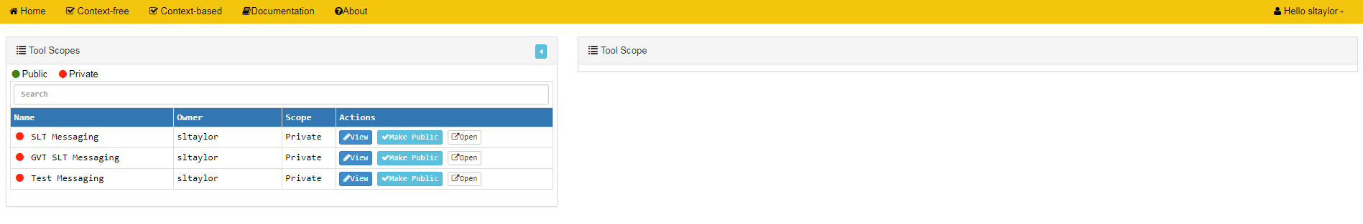
Accessing and Updating Tool Scope Settings (1)
From the Hello dropdown menu that displays to Account Users with Deployer Role, select Tool Scope Settings to add or edit Settings information for a Tool Scope
1
info
Current list of both Private and Public Tool Scopes created by GVT Account User who is logged in is displayed
info
info
View button allows Account Users with Deployer Role to display the Tool Scope Settings edit screen for the desired Tool Scope
Open button allows Account Users with Deployer Role to open a separate window to display the desired Tool Scope
info
√Make Public button displays for Account Users with Publisher Role

Slide 2
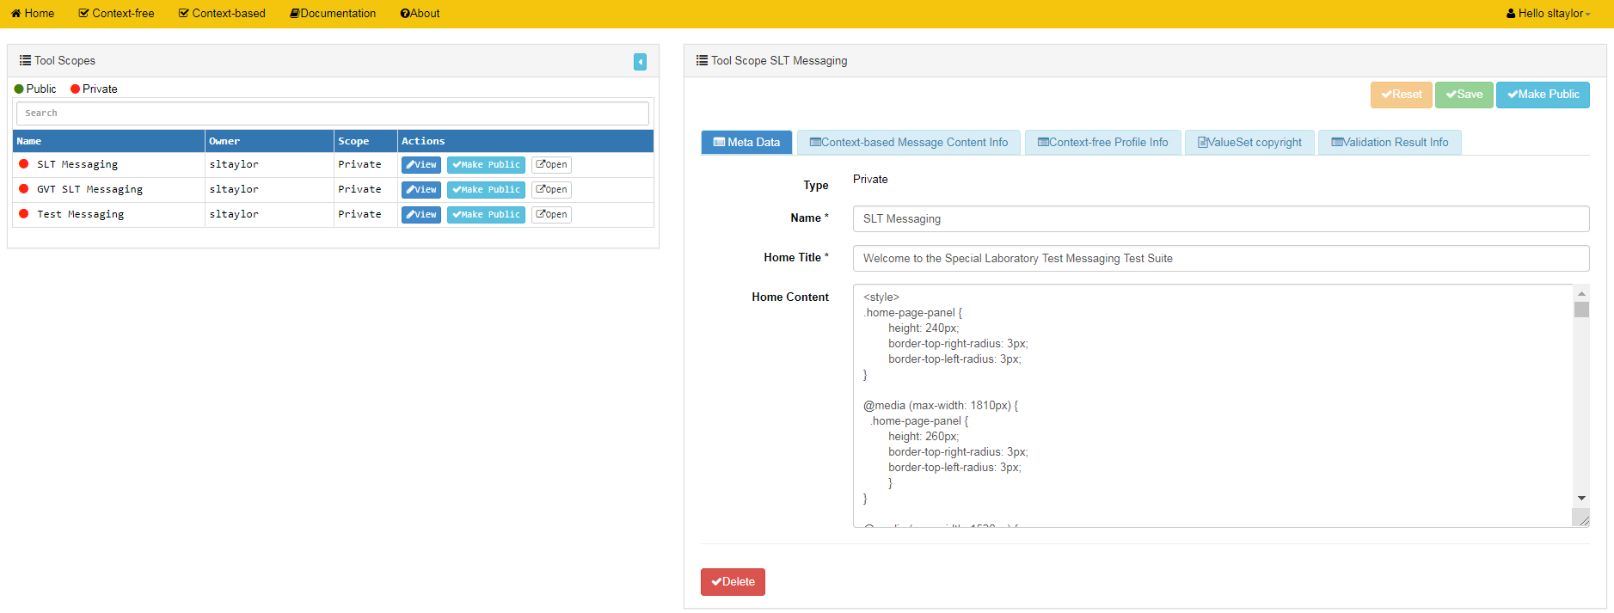
Accessing and Updating Tool Scope Settings (2)
info
“Private” is default setting
info
Tool Scope Settings edit screen for selected Tool Scope
Click on View button to display the Tool Scope Settings edit screen for the desired Tool Scope
2

Slide 3
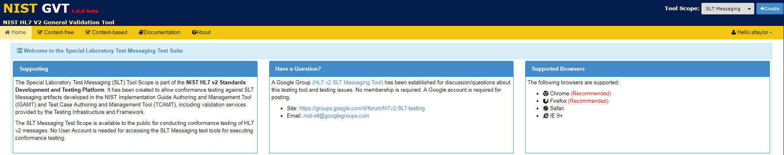
Accessing and Updating Tool Scope Settings (3)
shows where this information is used
info
Optional: For Account Users with Publisher Role, click on √Make Public to make this Tool Scope available to all GVT users
3
Using the Tool Scope Setting Meta Data edit screen, add or edit Meta Data information
Save Meta Data Tool Scope Settings or select another tab on this screen to add or edit data
4
info
Click on √Delete to delete this entire Tool Scope

Slide 4
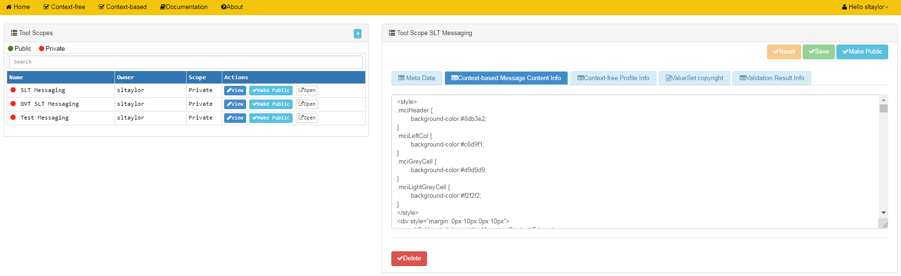
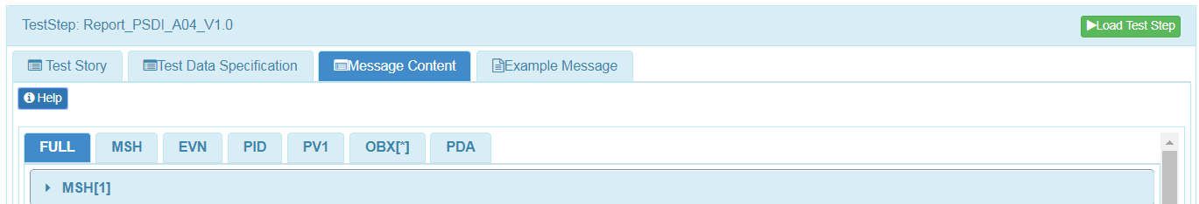
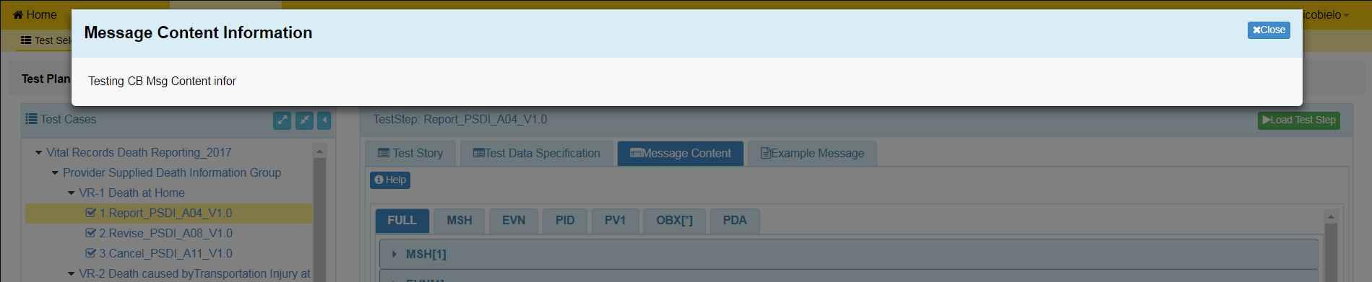
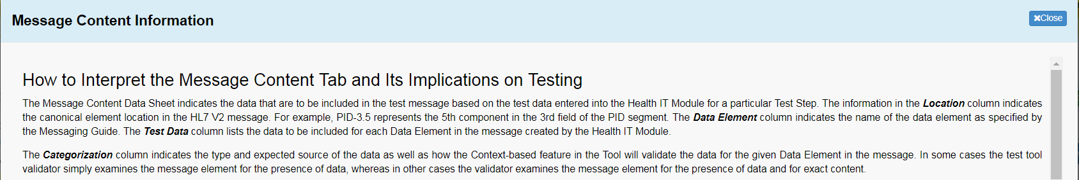
Accessing and Updating Tool Scope Settings (4)
shows where this information is used
5
Select the Context-based Message Content Info tab in the Tool Scope Setting edit screen and add or edit this information
Save Context-based Message Content Info or select another tab on this screen to add or edit data.
6

Slide 5
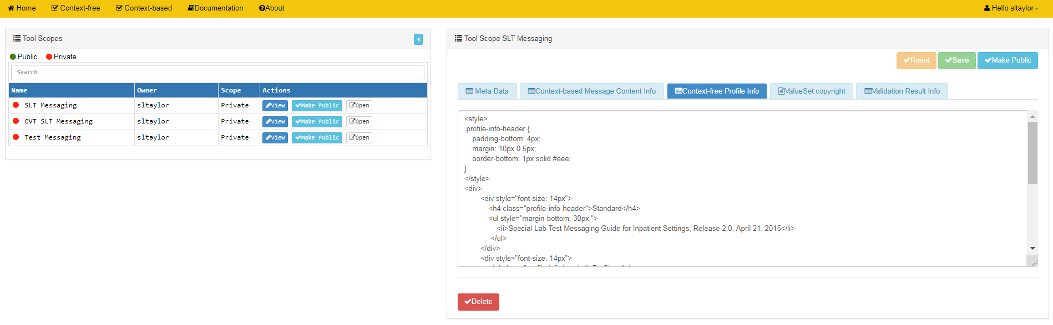
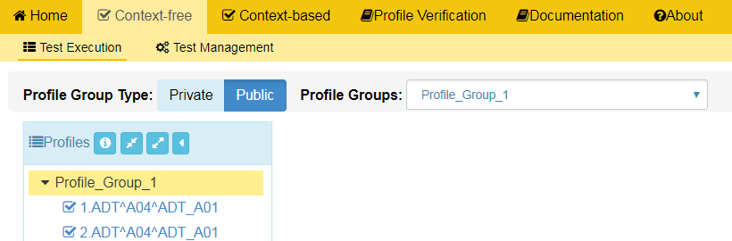
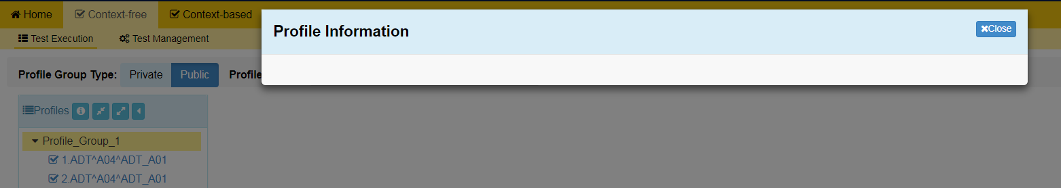
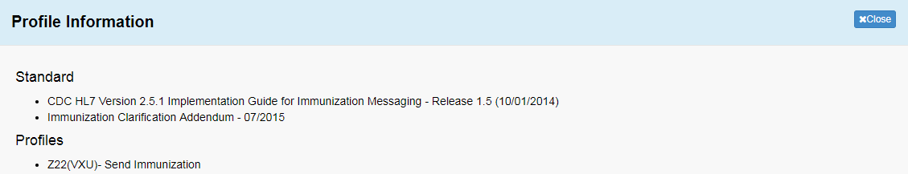
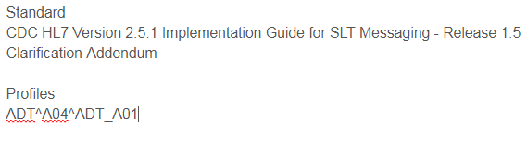
Accessing and Updating Tool Scope Settings (5)
shows where this information is used
7
Select the Context-free Profile Info tab in the Tool Scope Setting edit screen and add or edit this information
Save Context-free Profile Info or select another tab on this screen to add or edit data
8

Slide 6
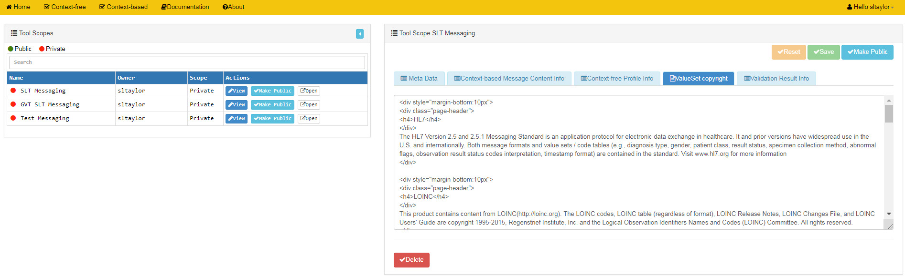
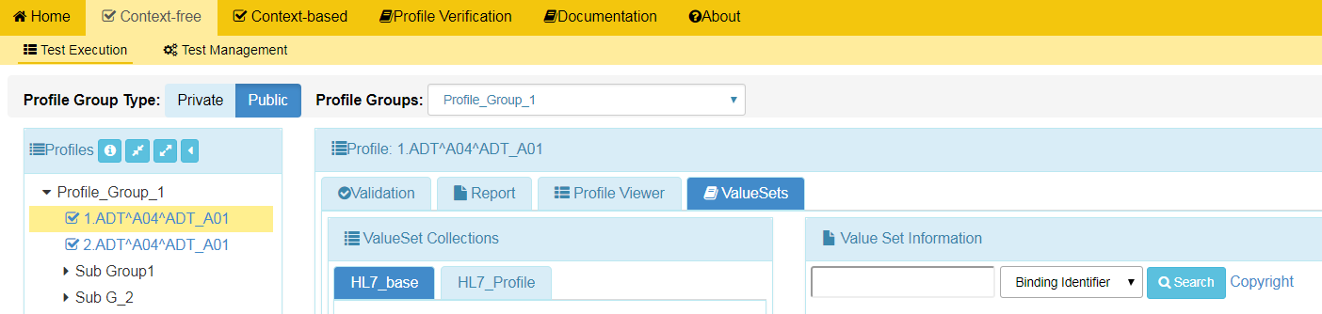
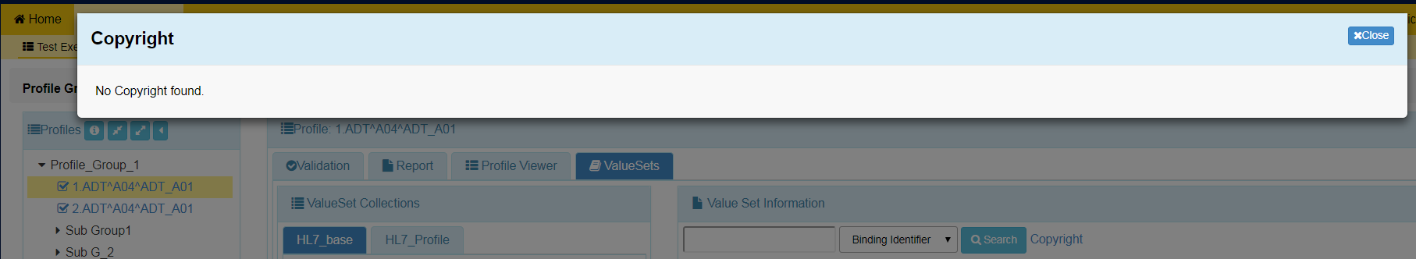
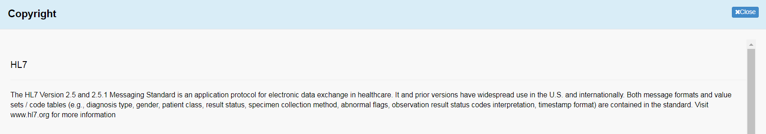
Accessing and Updating Tool Scope Settings (6)
shows where this information is used
9
Select the ValueSet Copyright tab in the Tool Scope Setting edit screen and add or edit this information
Save ValueSet Copyright or select another tab on this screen to add or edit data
10

Slide 7
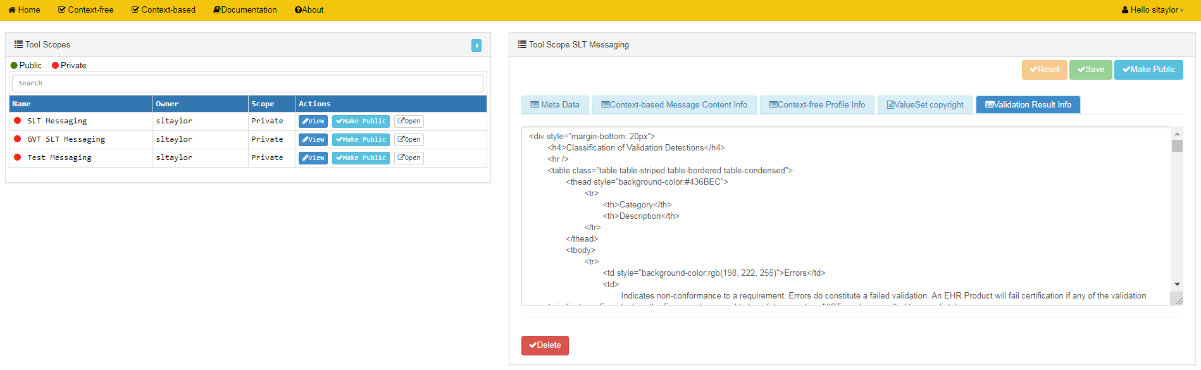
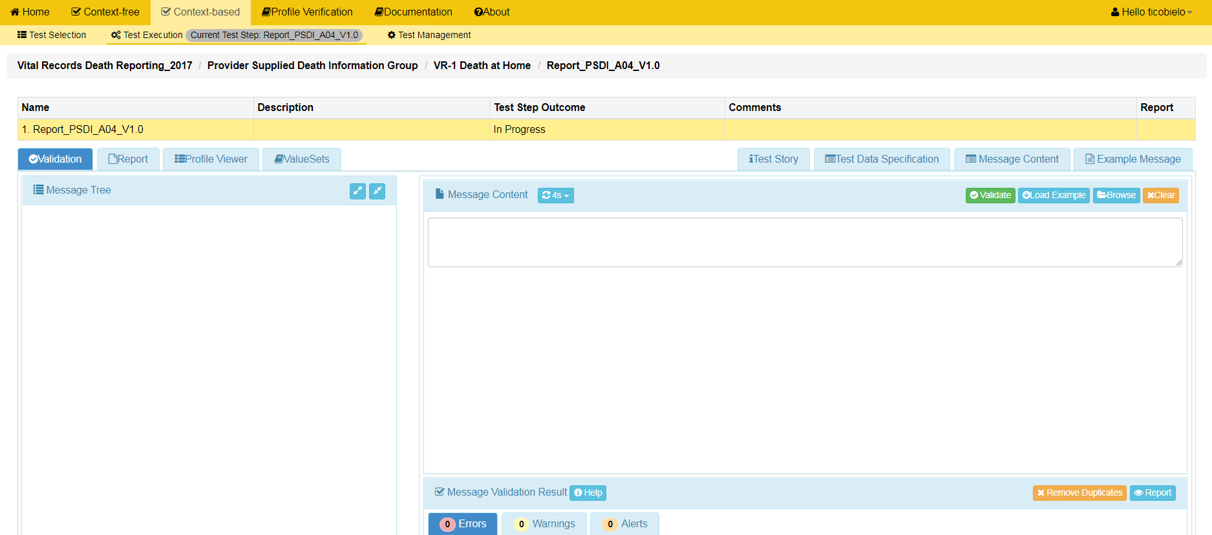
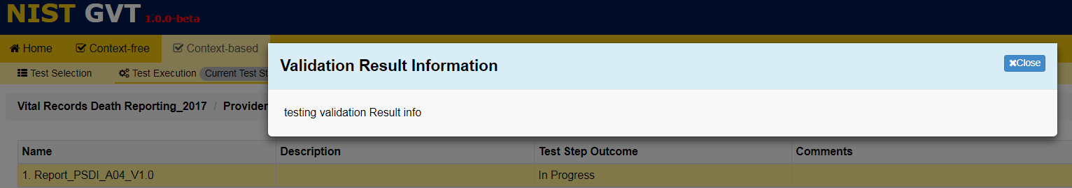
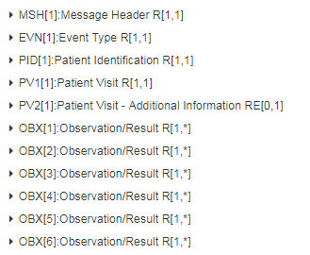
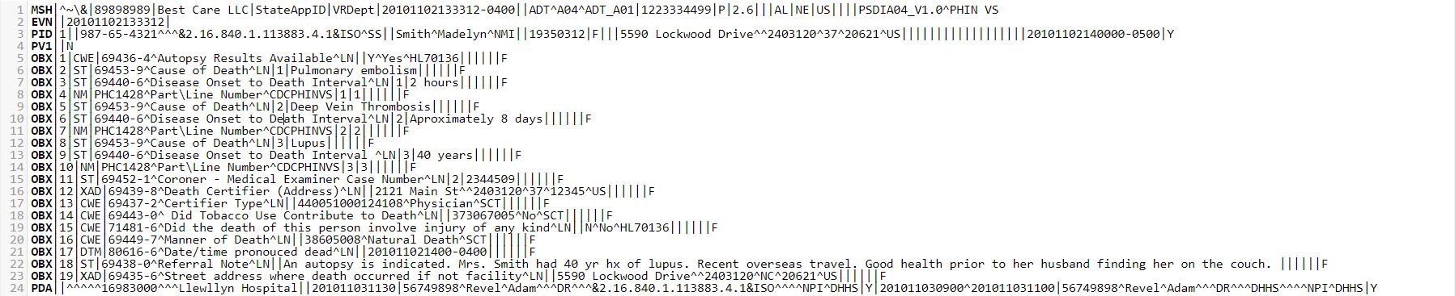
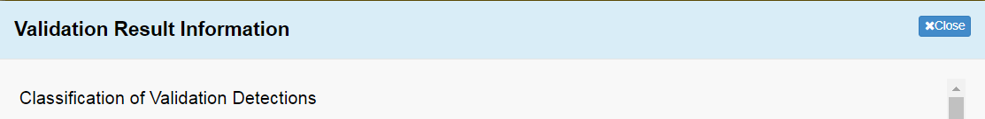
Accessing and Updating Tool Scope Settings (7)
shows where this information is used
11
Select the Validation Result Info tab in the Tool Scope Setting edit screen and add or edit this information
Save Validation Result Info or select another tab on this screen to add or edit data
12

